Slide 1
Comprehensive Pizza Sales Analysis
Using Advanced SQL Queries

Slide 2
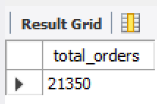
1. Retrieve the Total Number of Orders Placed
This query calculates the total number of pizza orders placed by customers.

Slide 3
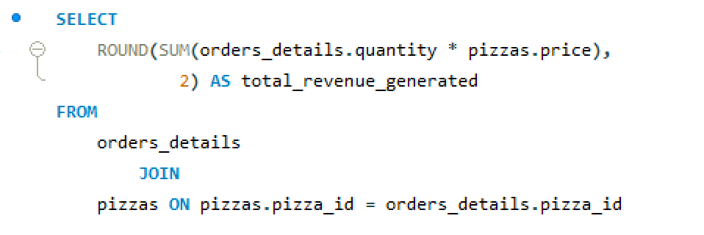
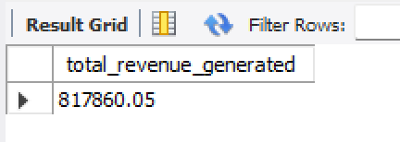
2. Calculate the Total Revenue Generated from Pizza Sales
This query determines the total revenue generated from all pizza orders by multiplying the quantity ordered by the price.

Slide 4
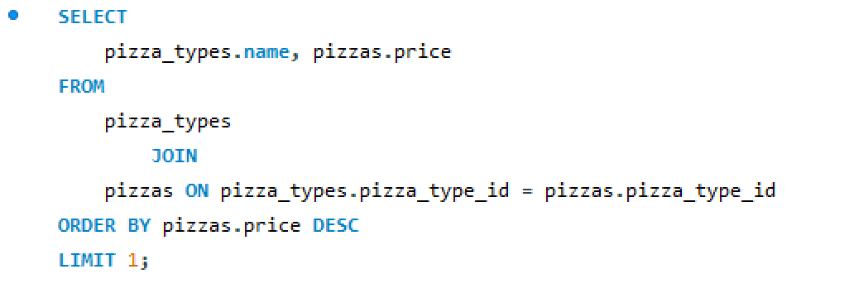
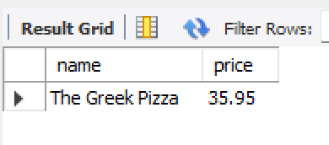
3. Identify the Highest-Priced Pizza
This query retrieves the most expensive pizza and its price.

Slide 5
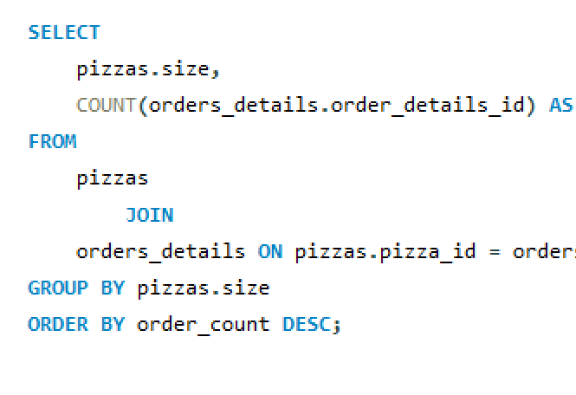
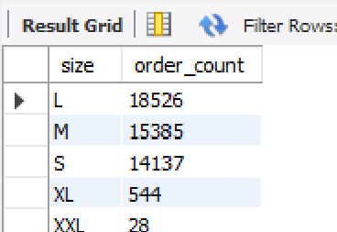
4. Identify the Most Common Pizza Size Ordered
This query finds out the most frequently ordered pizza size.

Slide 6
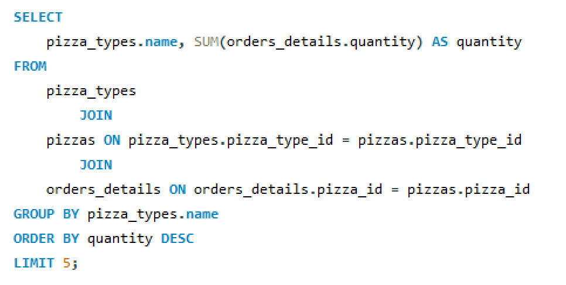
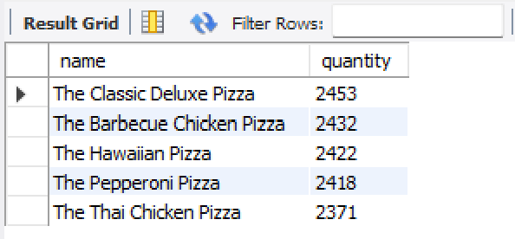
5. List the Top 5 Most Ordered Pizza Types with Quantities
This query provides the top 5 pizza types based on the total quantity ordered.

Slide 7
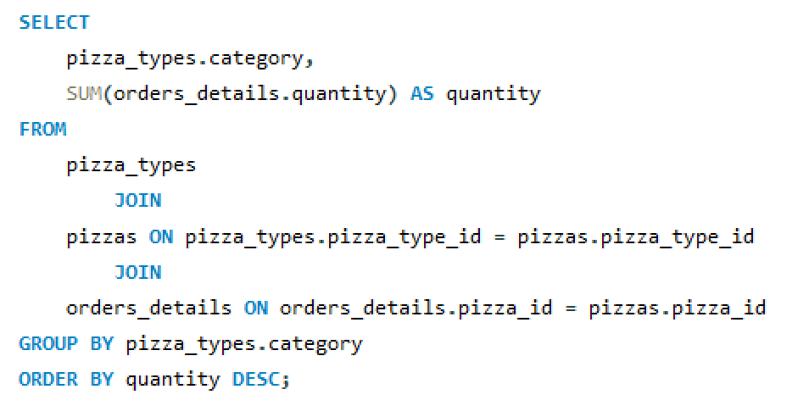
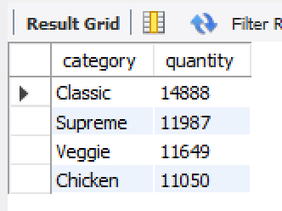
6. Total Quantity of Each Pizza Category Ordered
This query summarizes the quantity of pizzas ordered by their category (e.g. Classic, Supreme, Veggie, Chicken).

Slide 8
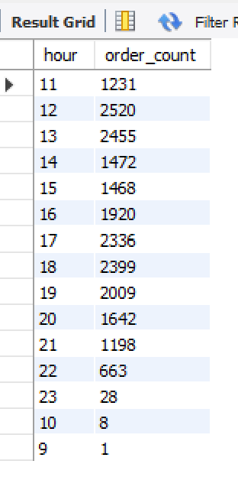
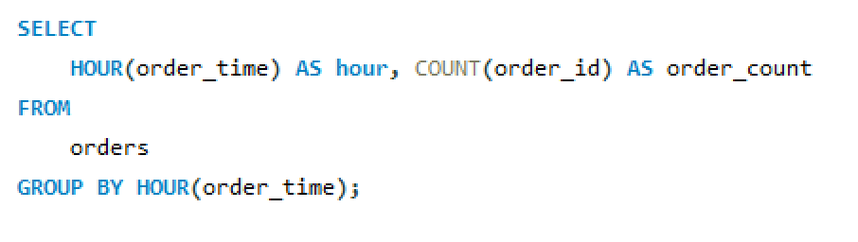
7. Distribution of Orders by Hour of the Day
This query shows when most orders are placed, grouping by hour.

Slide 9
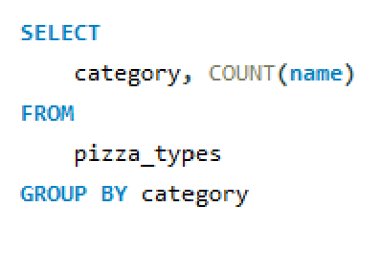
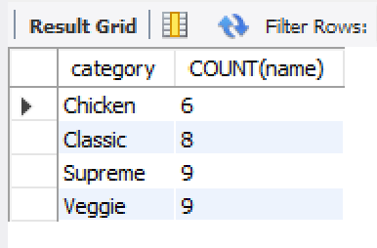
8. Category-wise Distribution of Pizza Orders
This query displays how pizza orders are distributed across different categories.

Slide 10
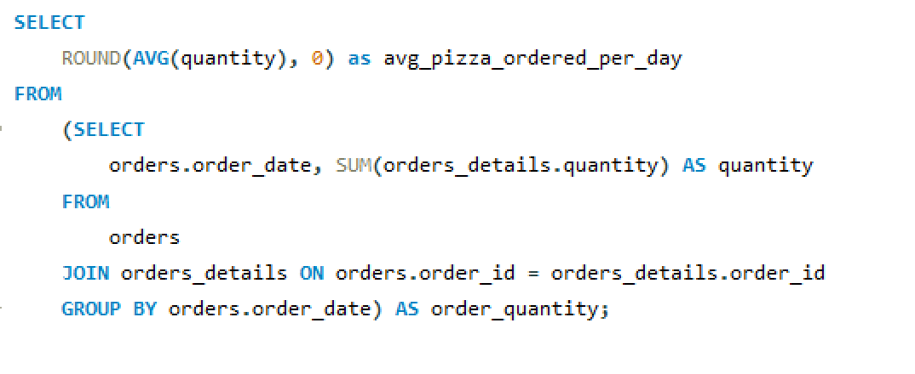
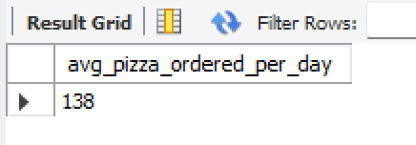
9. Average Number of Pizzas Ordered Per Day
This query calculates the average number of pizzas ordered daily.

Slide 11
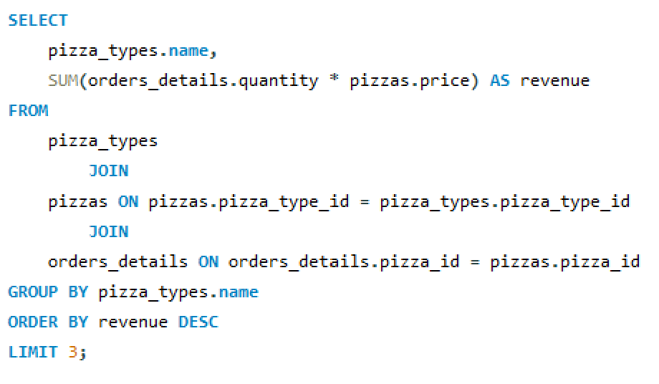
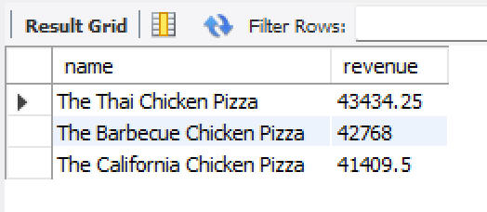
10. Top 3 Most Ordered Pizza Types Based on Revenue
This query lists the top 3 pizza types that generated the highest revenue.

Slide 12
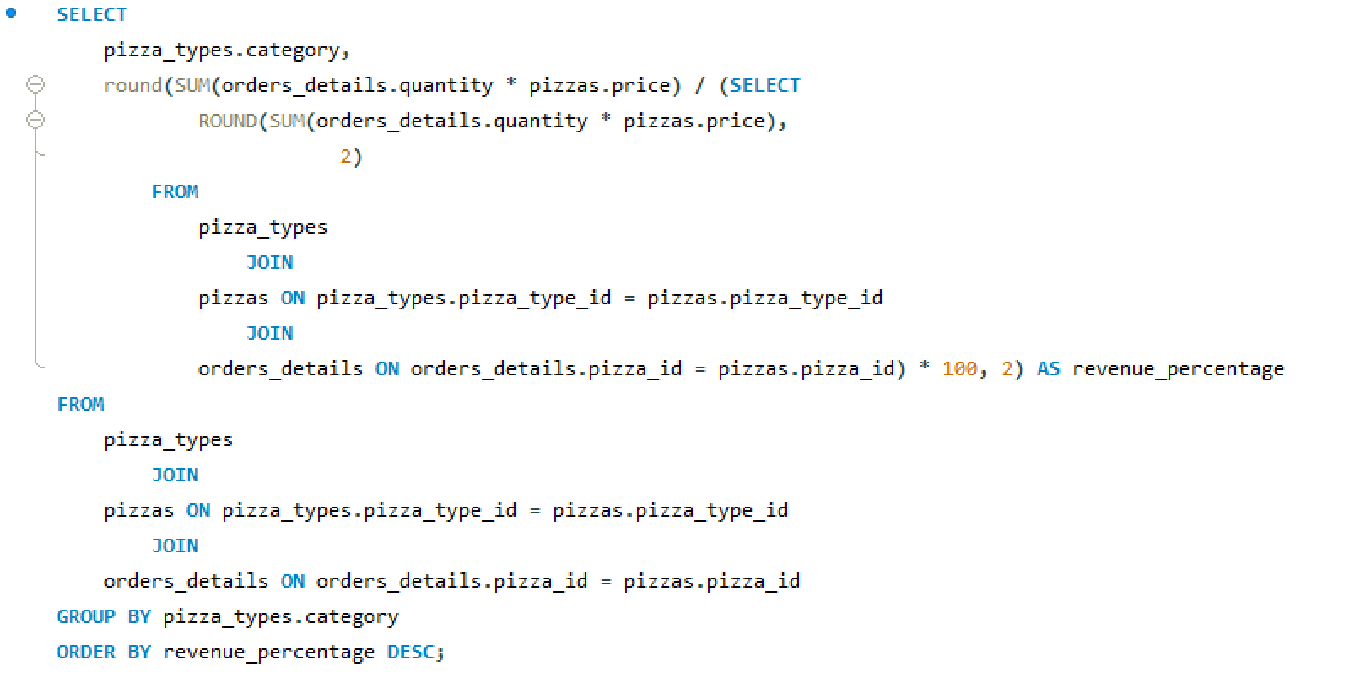
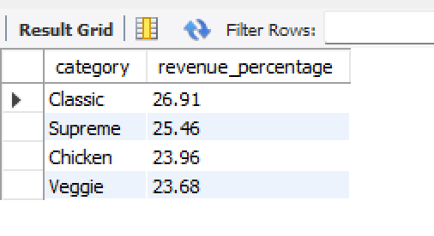
11. Percentage Contribution of Each Pizza Type to Total Revenue
This query shows the percentage of revenue each pizza category contributes to the total.

Slide 13
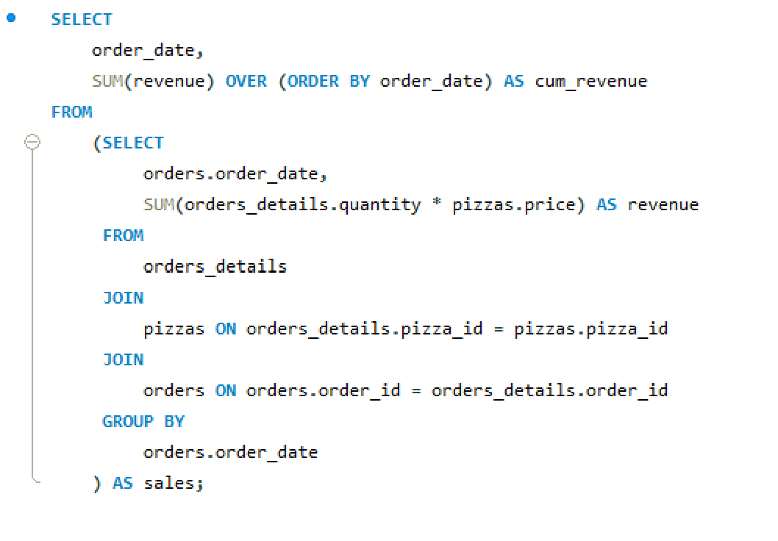
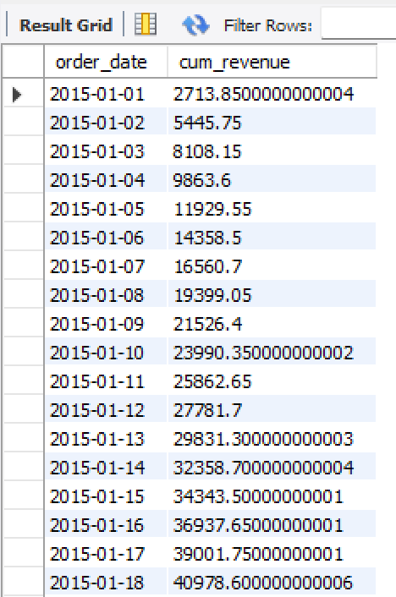
12. Cumulative Revenue Generated Over Time
This query shows the cumulative revenue generated as orders progress over time.

Slide 14
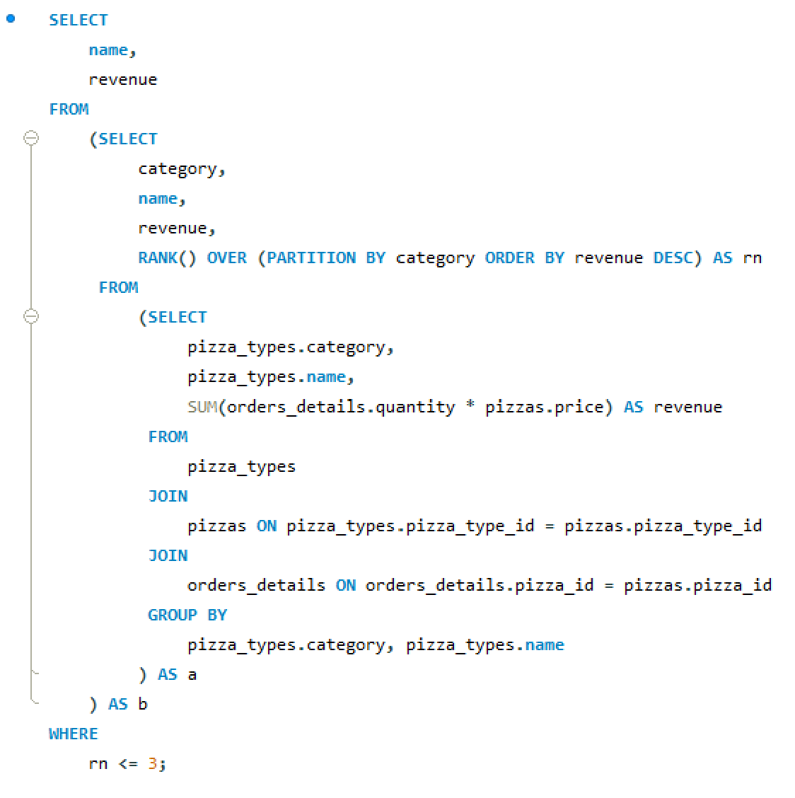
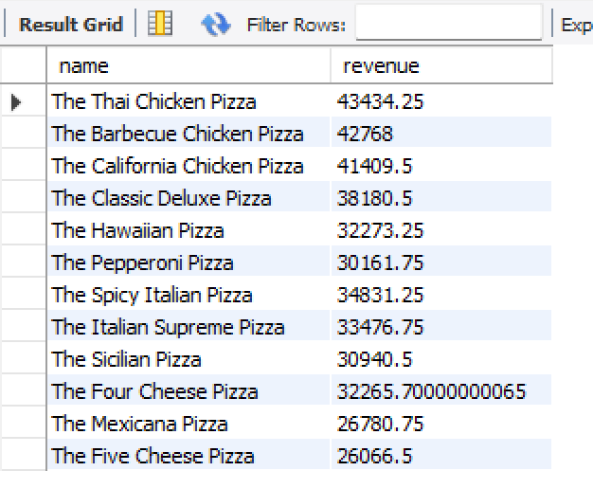
13. Top 3 Most Ordered Pizza Types Based on Revenue for Each Category
This query determines the top 3 pizza types based on revenue for each pizza category.

